Slide 1
Security and Authorization
Notes:
1

Slide 2
Introduction to DB Security
Secrecy: Users should not be able to see things they are not supposed to.
  E.g., A student can’t see other students’ grades.
Integrity: Users should not be able to modify things they are not supposed to.
  E.g., Only instructors can assign grades.
Availability: Users should be able to see and modify things they are allowed to.

Slide 3
Access Controls
A security policy specifies who is authorized to do what.
A security mechanism allows us to enforce a chosen security policy.
Two main mechanisms at the DBMS level:
  Discretionary access control
  Mandatory access control

Slide 4
Discretionary Access Control
Based on the concept of access rights or privileges for objects (tables and views), and mechanisms for giving users privileges (and revoking privileges).
Creator of a table or a view automatically gets all privileges on it.
  DBMS keeps track of who subsequently gains and loses privileges, and ensures that only requests from users who have the necessary privileges (at the time the request is issued) are allowed.

Slide 5
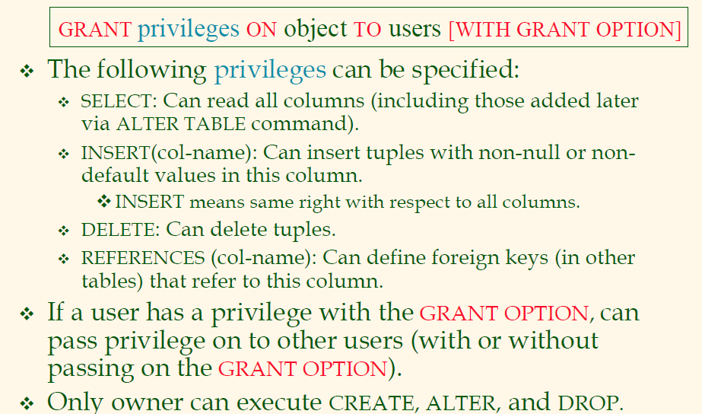
GRANT Command

Slide 6
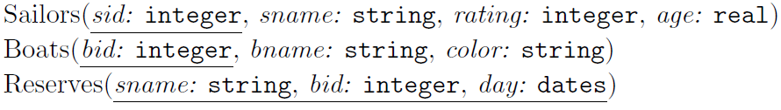
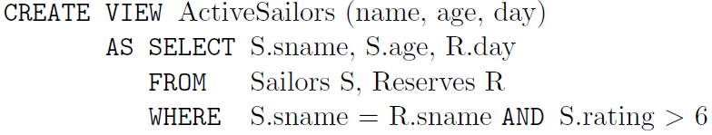
Schemas of Running Examples

Slide 7
GRANT and REVOKE of Privileges
GRANT INSERT, SELECT ON Sailors TO Horatio
  Horatio can query Sailors or insert tuples into it.
GRANT DELETE ON Sailors TO Yuppy WITH GRANT OPTION
  Yuppy can delete tuples, and also authorize others to do so.
GRANT UPDATE (rating) ON Sailors TO Dustin
  Dustin can update (only) the rating field of Sailors tuples.
GRANT SELECT ON ActiveSailors TO Guppy, Yuppy
  This does NOT allow the ‘uppies to query Sailors directly!
REVOKE: When a privilege is revoked from X, it is also revoked from all users who got it solely from X.

Slide 8
GRANT/REVOKE on Views
If the creator of a view loses the SELECT privilege on an underlying table, the view is dropped!
If the creator of a view loses a privilege held with the grant option on an underlying table, (s)he loses the privilege on the view as well; so do users who were granted that privilege on the view!

Slide 9
Views and Security
Views can be used to present necessary information (or a summary), while hiding details in underlying relation(s).
  Given ActiveSailors, but not Sailors or Reserves, we can find sailors who have a reservation, but not the bid’s of boats that have been reserved.
Creator of view has a privilege on the view if (s)he has the privilege on all underlying tables.
Together with GRANT/REVOKE commands, views are a very powerful access control tool.

Slide 10
Role-Based Authorization
In SQL-92, privileges are actually assigned to authorization ids, which can denote a single user or a group of users.
In SQL:1999 (and in many current systems), privileges are assigned to roles.
  Roles can then be granted to users and to other roles.
  Reflects how real organizations work.

Slide 11
Mandatory Access Control
Based on system-wide policies that cannot be changed by individual users.
  Each DB object is assigned a security class.
  Each subject (user or user program) is assigned a clearance for a security class.
  Rules based on security classes and clearances govern who can read/write which objects.
Most commercial systems do not support mandatory access control. Versions of some DBMSs do support it; used for specialized (e.g., military) applications.

Slide 12
Why Mandatory Control?
Discretionary control has some flaws, e.g., the Trojan horse problem:
  Dick creates table Horsie and gives INSERT privileges to Justin (who doesn’t know about this).
  Dick modifes the code of an application program used by Justin to additionally write some secret data to table Horsie.
  Now, Dick can see the secret info.
The modification of the code is beyond the DBMSs control, but it can try and prevent the use of the database as a channel for secret information.

Slide 13
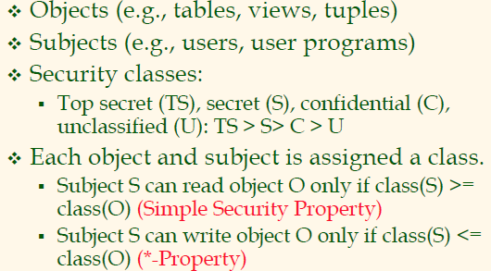
Bell-LaPadula Model

Slide 14
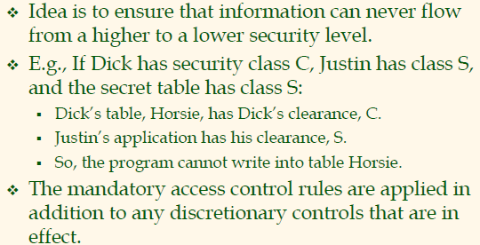
Intuition

Slide 15
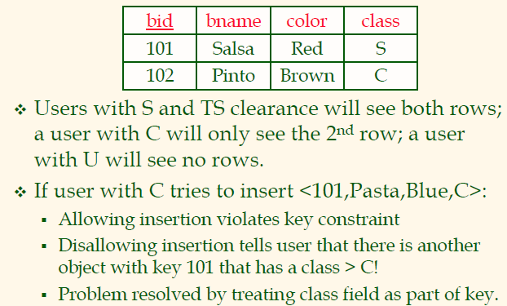
Multilevel Relations

Slide 16
Internet-Oriented Security
Key Issues: User authentication and trust.
  When DB must be accessed from a secure location, password based schemes are usually adequate.
For access over an external network, trust is hard to achieve.
  If someone with Sam’s credit card wants to buy from you, how can you be sure it is not someone who stole his card?
  How can Sam be sure that the screen for entering his credit card information is indeed yours, and not some rogue site spoofing you (to steal such information)? How can he be sure that sensitive information is not “sniffed” while it is being sent over the network to you?
Encryption is a technique used to address these issues.

Slide 17
Summary
Three main security objectives:
  secrecy, integrity, availability.
DBA is responsible for overall security.
  Designs security policy, maintains an audit trail, or history of users’ accesses to DB.
Two main approaches to DBMS security: discretionary and mandatory access control.
  Discretionary control based on notion of privileges.
  Mandatory control based on notion of security classes.

